Slide 1

HCI - Assignment n.2
Design and prototyping of an application using a human-centered approach
Deliverable n. 1: Requirement Analysis
Project Title: ScoutPanel
Group: Daniel Silva, Marco Almeida, Adalberto Vaz do Rosário Rosário
Lab Class: P5
HCI 2020-2021

Slide 2
Introduction
ScoutPanel
ScoutPanel is a platform that allows scouts (or their parents) to perform actions and consult information related to their scout unit
We chose this project because one of the members of the group is a scout and knows the movement very well, being from São Tomé and knowing the need to have a system to facilitate and help in the management of this group, which, according to him, is a large group and currently the only one means of management is paper and ballpoint pen. Using the useful and the pleasant, he proposed the theme and we found it interesting to use in the work of the discipline.
We have personal interest in this project because as our colleague would like to implement this project in the real world, we as a group would like to take the opportunity to, in addition to doing the project from an academic point of view, also live the work experience in the real world.
HCI 2020-2021
2

Slide 3
Project Objectives
ScoutPanel
Define high-level goals.
Chat with other members of the unit
Share photos with other scouts/parents
Pay fees through online platforms
Check news and future activities
Manage enrolled scouts
What are the expected outcomes?
Having a platform with a simple (and easy to navigate) user interface and the aforementioned features
What are the benefits?
Communication between members without needing an external platform (e.g. Facebook)
Less reliance on paper records for management
Common news feed available to all members
HCI 2020-2021
3

Slide 4
Personas
ScoutPanel
Maria Alves
19 years old
Student
Is enrolled in the Movimento de Escuteiros de Trindade, troop n.º 2
Would like to share photos that she took during activities with the other scouts and parents
Gabriel Nogueira
30 years old
Professor
Leader of scout troop n.º 2
Would like to manage the list of enrolled scouts and verify their payments without needing to check paper records
HCI 2020-2021
4

Slide 5
Scenarios
ScoutPanel
Scenario 1:
Maria took a lot of photos during the last scout activity and now wants to share them with other scouts and parents, without making them public, so that only them can see the pictures.
To do this, she will open the ScoutPanel platform and post the photo album in a feed that is shared between all members.
They will all receive a notification, which they can click to see the photo album. All pictures will be kept in the feed so that they can be seen in the future.
Scenario 2:
Gabriel wants to enroll a new member to the scout troop n.º 2.
To do this, he will open the ScoutPanel platform and go to the “new member” page. He will fill all the information about the new member and submit the registration form.
The new member will be added to the members list, which can be seen by everyone on the platform.
HCI 2020-2021
5

Slide 6
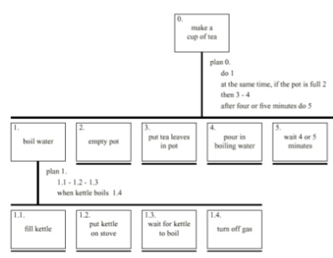
Tasks
ScoutPanel
For each scenario indicate the main tasks that users will perform using the application;
Identify relevant issues of the context of use, if necessary (e.g. mobile usage, noise, dust, stress level, etc.);
Which tasks will become easier using the application (taking advantage of the new capacities) and how they are performed currently (without the application)?
Include the decomposition of the main task.
HCI 2020-2021
6

Slide 7
Requirements
ScoutPanel
Define a set of requirements (non-functional, functional, …) based on the objectives and personas:
Non-functional requirements – The system must communicate with the SQL Server database; The monthly fee invoice must be provided every first Sunday of the month; The payment receipt must be sent no later than 48 hours after payment, on working days;
Functional Requirements - Make quota payments through credit or debit; Consultation and alteration of the scouts' personal data; Inquiry of monthly fee or debt; Issuance of receipt of payments; Share and publish photos of activities; Consultation and change of subscribers by section heads; Receive notifications;
HCI 2020-2021
7

Slide 8
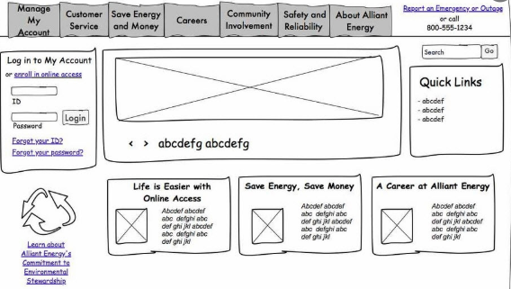
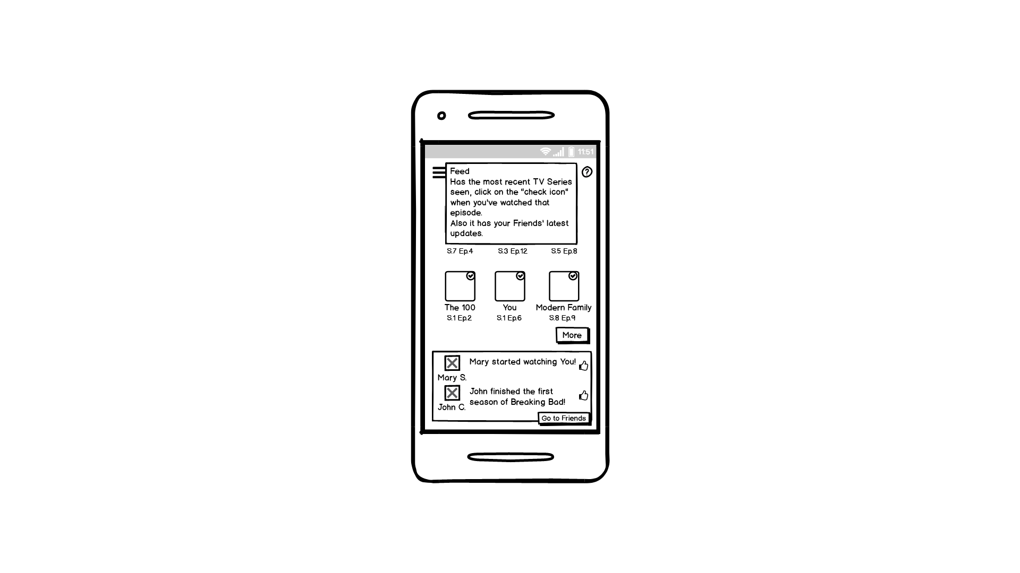
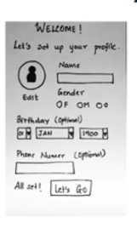
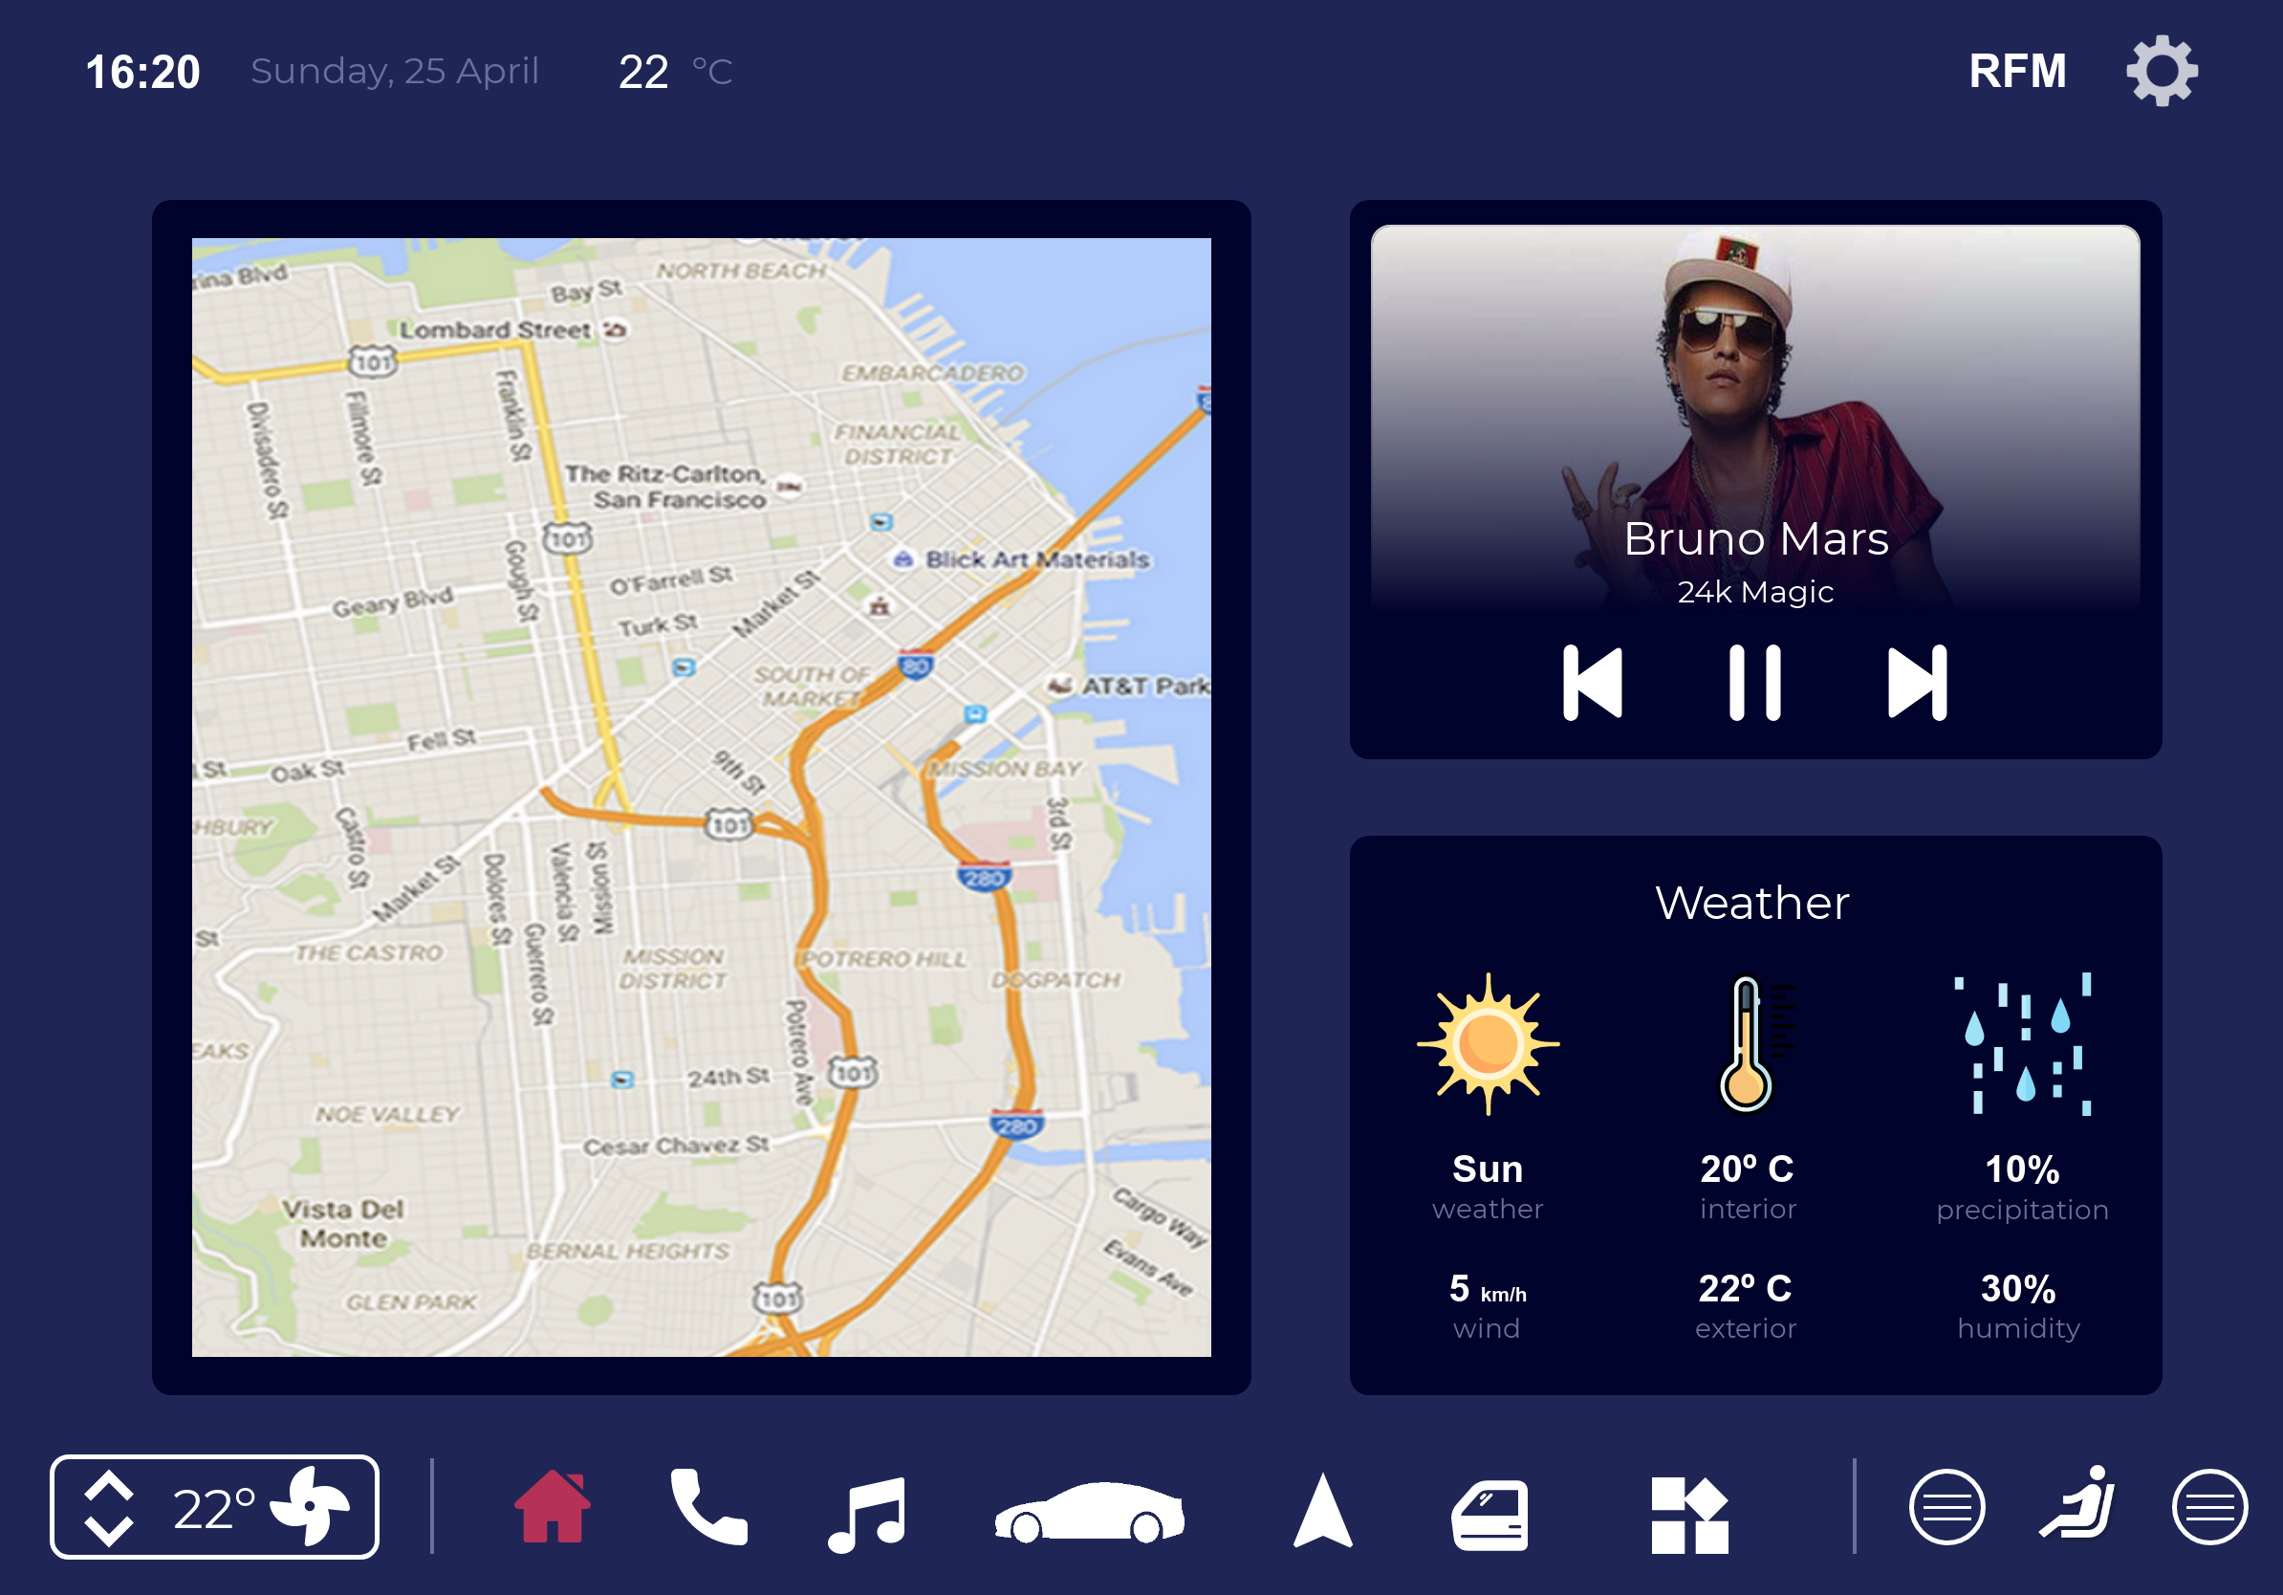
Next steps
ScoutPanel
We are considering making a digital prototype, using tools such as proto.io
We’ll test the prototype by observing users trying to perform tasks on it and asking questions based on their experience with the interface
HCI 2020 - 2021
8

